Slide 1


Juleslist
Team Members: Julian Ingledew, Marc Murray, Valdeck Rowe, Ritesh Reddy
Team Name: Ital Curry
Jamaica

Slide 2

Agricultural Trading Platform
Currently there’s no feasible way for farmers and buyers across the nation to connect to each other directly without a 3rd party’s intervention.

Slide 3
Juleslist
Used open data
To verify that farmer identity using RADA registration number
To identify farm locations, types of crops and size of farm
For price guidance for both buyers and farmers
Our solution will open up a new avenue for direct trade between farmers and buyers
Our solution is 60% complete as of now
Farmers, small and medium sized restaurants, and grocery stores.
Our solution is accessible via the web on computers and smart phones and for those without smart phones, they may be a part of the system through SMS
Maintains the privacy of/for all RFQs and Quoataions/bids

Slide 4
Business Model
How do you intend to keep the project sustainable?
Allow users to use the system for free if their transactions are below a certain value or volume
Higher Volumes/Value transactions attract a small commission
Farmers with consistently high volumes are asked to pay a fixed monthly subscription fee
How is this business model attractive for your customers?
Farmers:
It allows farmers access to the market with very little overhead
It allows farmers to request market prices for their goods
Buyers:
No middleman involved, so lower priced goods
Source fresh produce, even during times of scarcity

Slide 5
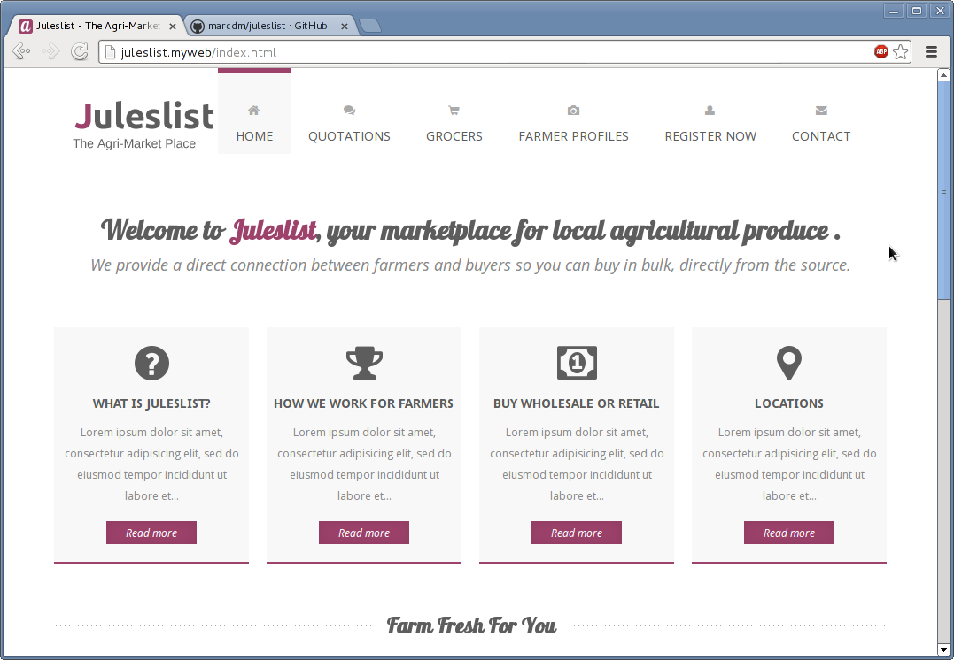
Demonstration

Slide 6
Questions?

